Slide 1
Enterprise Architech Presentation
Team 1

Slide 2
Content
Architecture Vision
Business Architech
Information Architech
Application Architech
Technology Architech
Opportunity and Solution
Migration plan
Governance

Slide 3
Architecture Vision

Slide 4
Concerns
Stakeholder | Key Concern
Customer | Ability to place order with higher turn around date
CxO | Losing sales? Prevent delay of shipment errors, Higher SLA, Cutting cost
Sales Team | Real time sales order generation, and faster feedback from RFQ, Improve Up time for VMS and CMS, at the same time improve customer service level through usage of technology
Order Processing Team | To have real time checking on vessel availability and container availability
IT and Operations | Sceptical on the investment of the new IT business goals, as they have no confident on the new system and technologies
Container Management Team | To have better recorded network with tow head operator, and hope could improve the efficiency of the local tow head operators. Current operation take too long to query a certain information from local tow head operator

Slide 5
Business Vision
restructuring and reorganising the processes
improvement in terms of revenue and operating profit
modularity within department
shared services / Information across multiple department

Slide 6
Change Drivers & Opportunities
Increase Operation Profit
Traceability of cost, network, and shipping movement
Losses of sales revenue
Usage of ecommerce
Cluttered business process flow
Underutilized computer resources
Poor support of current IT structure
Information availability and readiness
Service Oriented Architecture
Use of standard interface data format

Slide 7
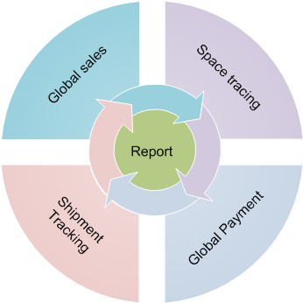
Environment and Process Models
Global Sales , where it handle all the sales from internal staff or external customer
Space Tracing ¸ for vessel and container availability with the predefined routes and calculation of the most effective cost
Global Payment , that handle the payment from customer and billing from third party vendors. The process will handle in multiple currency
Shipment Tracking to ensure the success and prevent losses of every delivery

Slide 8
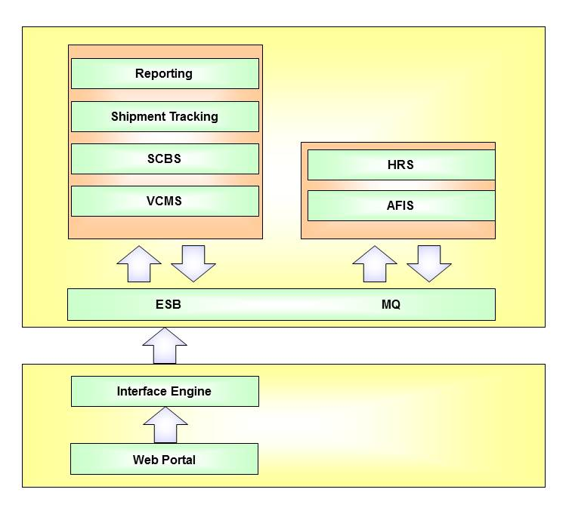
Target Architecture Model

Slide 9
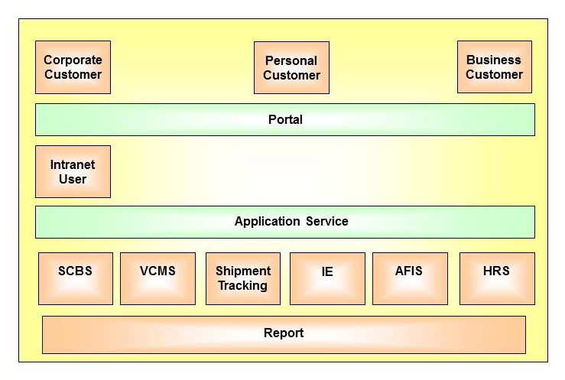
Architecture support process

Slide 10
Constraints
Staff skill set
Transition period for critical system
Infrastructure capability
Information exchange between local horizon office
Internal Politics
Budgeting

Slide 11
Transition Artifacts

Slide 12
Business Architecture

